Slide 1

Do surroundings influence the nature of crime in a city ?
Capstone Project
-Nutan

Slide 2



Among other variables, Surrounding venues have a clear impact on the nature of the crimes in Toronto
“Black Creek , West hill neighborhoods in the North Western & eastern Toronto have a higher proportion of Robbery especially around Fast Food restaurants , Pizza Places & Grocery stores”
“Houses in the western and eastern suburbs and near parks are related to more Break and Enter Crimes”
“~60% of all Assault cases in Toronto , happen near the downtown area and 40% of those happen close to coffee shop. Sundays & Commercial premises add to the factors which impact the likelihood of Assault”

Slide 3





Structure & Agenda
Problem & Approach
Methodology & Algorithms Used
Exploratory Data Analysis
Clustering
Next Steps & Further Analysis possibilities

Slide 4
Problem & Approach
Problem
Analyse & understand the relationship of how the surrounding venues impact the nature of the crime in a city
Targeted Towards
Toronto Police -to equip them with quantitative information so crime can be better understood and averted
New residents & Commercial property owners - to safeguard themselves better
Approach
Data from Toronto Police on Major crimes combined with venue data from foursquare.
This combined data with details of the crime and the venues surrounding the crime scene is put through unsupervised clustering algorithm
Results are analysed to build an understanding of the relationship between venues and nature of crime

Slide 5
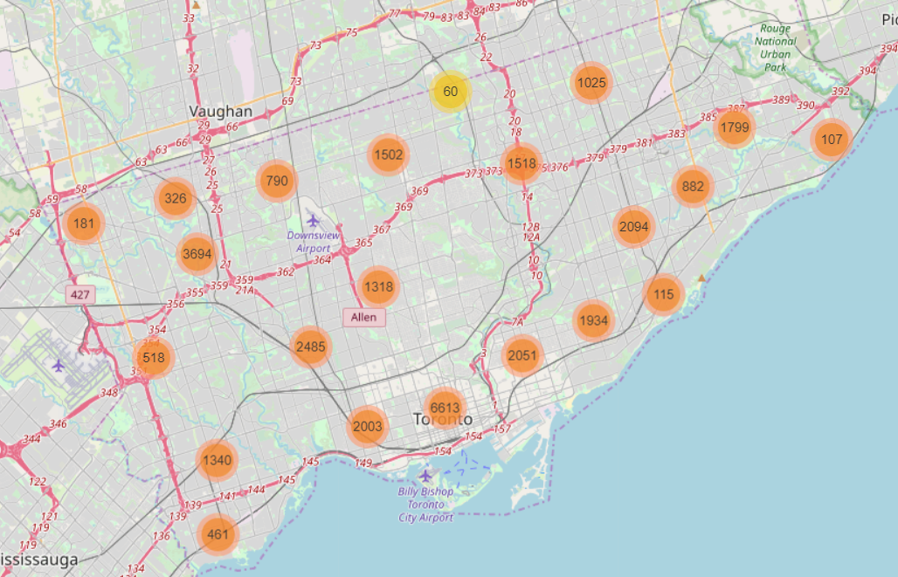
Methodology & Algorithms Used
MCI or Major Crime Indicator data from Toronto Police has the crime scene location, which was used to fetch surrounding venues within a 300m radius
After restricting to 2016 data only , there were 32K crimes listed in the city , with ~16% of those around the down town area and rest spread out across the city

Slide 6
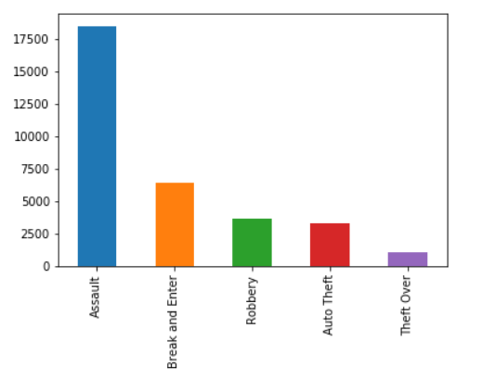
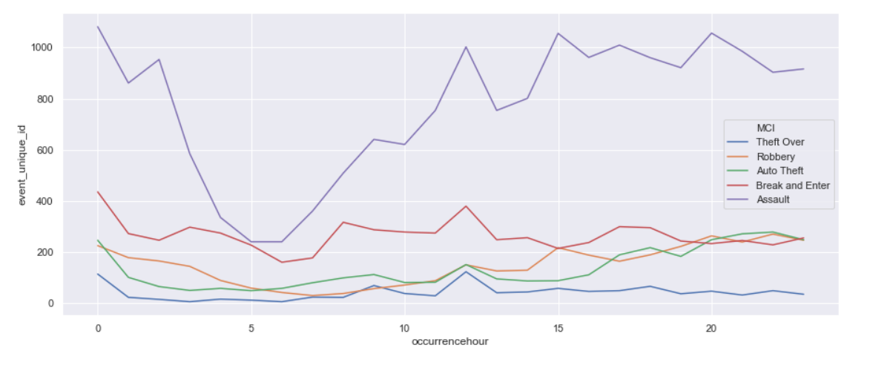
EDA tells us - Assault as a crime was the most frequent. Midnight and Weekends were more prone
Basic EDA resulted in the following observations
Assault is a very prevalent crime and is almost 3X more frequent than the next frequent crime – Break and Enter.
Summer months have a higher crime rate than the winter months, with the exception of October
Weekends have a higher crime rate in general except for Break & Enter which peaked on Friday only
Assault is highest at midnight, but is also higher in the evenings & nights
Break & Enter has a different pattern, its relatively flat all through out the day but has a high during midnight(possibly as lesser number of people would be around )
Auto Theft, Robbery are more frequent during evenings and nights

Slide 7
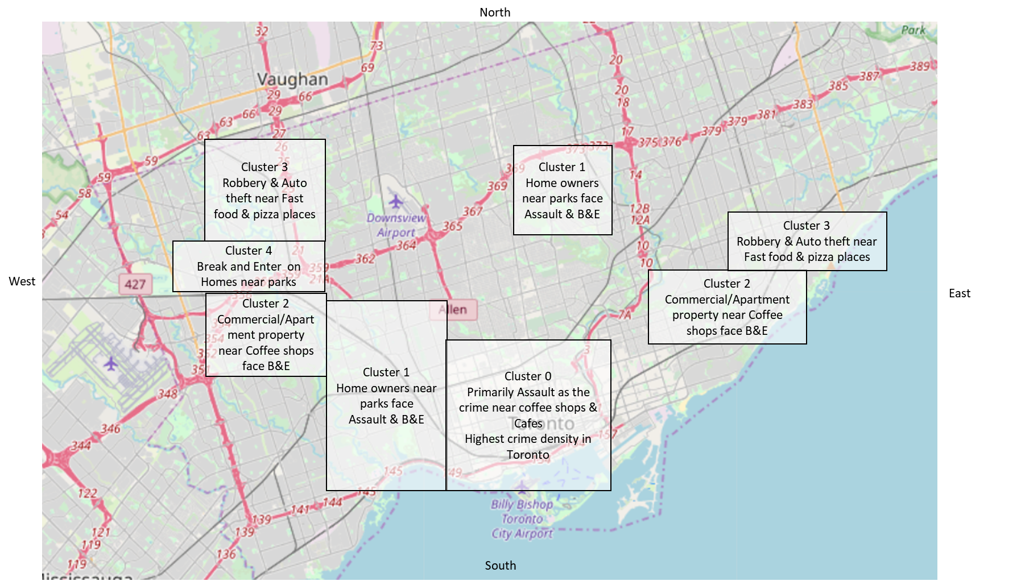
Clustering Algorithm resulted in 5 clusters with distinct patterns
Cluster 0 – Centred around down town, Almost all MCI Crime types are higher in absolute numbers. Crime scenes largely are around Coffee shops and Cafes
Cluster 1 – Assault, Break and Enter are relatively higher with the risk majorly around homes near parks
Cluster 2 – Comparable to cluster 1 in some ways with difference in the targets of crime. Focusses on Apartments and Commercial spaces with Coffee shops in the neighbourhood.
Cluster 3 –Robbery and Auto Theft around Fast Food joints and Pizza places seem to be relatively higher
Cluster 4 – Largely Break and enter crimes on homes in the western suburbs of Toronto. Parks seem to be closest to these crime scene

Slide 8
Next Steps & Further Analysis possibilities
This can be extended with more attributes from the Toronto Open data portal.
Simple addition of demographics data to the existing Neighbourhood data and then clustering will help us understand if senior resident areas have a crime vs areas with working parents.
Economic and Well being indicators can also be added to further analyse and understand the reasons for the crime and how it can be fundamentally addressed.

